Slide 1
SMA Case Study
Group No. 10
Topic:
Social Media Analytics for Behavioral Health
Group Members:
Sanjana Asrani D17B/01
Ritika Bhat D17B/08
Ayush Jain D17B/28
Digvijay Kocharekar D17B/36

Slide 2
Introduction
More than 0.8 million people die from suicide every year worldwide. Suicide ranks as the tenth leading cause of death in the United States and the ninth leading cause in Canada. In the USA, a person commits suicide approximately every 11.1 minutes, highlighting the urgency of addressing this issue.
The COVID-19 pandemic has exacerbated mental health challenges due to economic uncertainty and social isolation. Clinical psychologists and researchers have observed a surge in mental health problems exacerbated by exposure on social media platforms during lockdowns.
England faced a backlog of 21.6 million people waiting for mental health care in August 2021. An estimated 8 million individuals were deemed ineligible for specialist help, emphasizing the need for automated mental health detection from social media data.

Slide 3
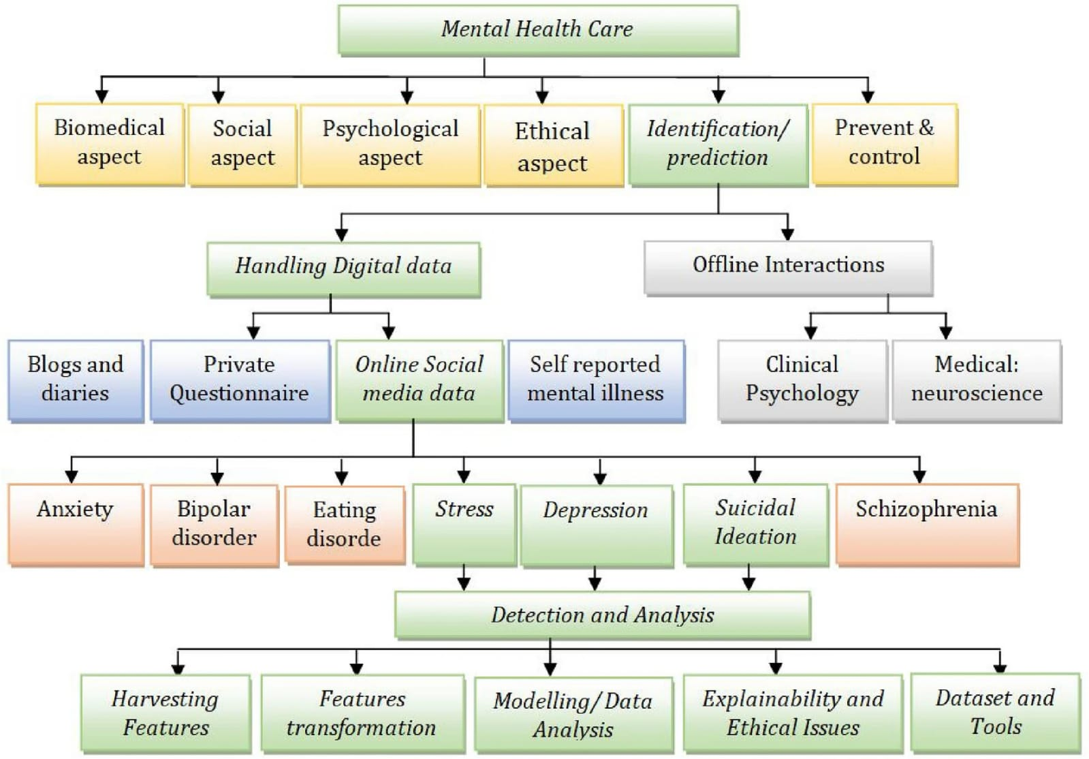

Slide 4
Social Media Platforms
Social Networking Platforms:
Facebook, LinkedIn, Google, TikTok, Vlive
Media Sharing Networks:
Instagram,YouTube,
Twitter, Wattpad
Resources
Discussion Forums and Communities:
Reddit,Quora,Discord
Messaging Apps:
WhatsApp, Telegram ,Facebook Messenger
Gaming and Virtual Communities:
Minecraft,Roblox,Twitch

Slide 5

How it helps Mental Health?
Sharing Hobbies and Interests: Creativity and Artistic Expression
Seeking Professional Help and Resources
Reducing Social Isolation
Access to Online Therapy and Counseling
Mindfulness and Meditation Apps
Fitness Communities

Slide 6
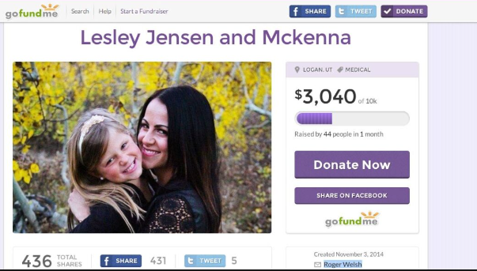
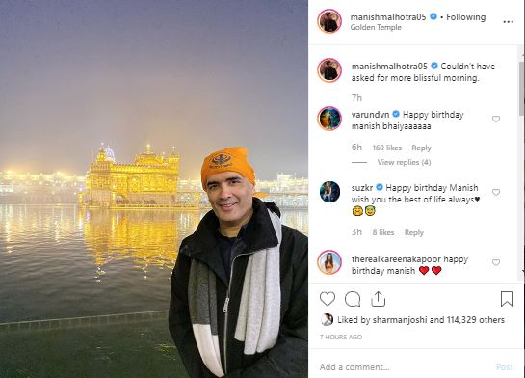
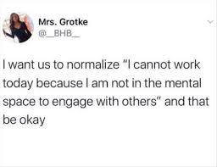

Fundraisers to help people online:
Positive Influence:
Proper Guidance:
Supporting the needy & Spreading Awareness:

Slide 7
How it becomes a bane
Social Comparison and Low Self-Esteem
Cyberbullying and Harassment
Addiction and Time Wasting
Distorted Perception of Reality
Privacy Concerns and Data Exploitation
Decreased Face-to-Face Interaction
Misinformation and Echo Chambers: where individuals are exposed only to information that aligns with their existing beliefs,
leading to polarization and division in society.
Fear of Missing Out (FOMO): individuals feel anxious or inadequate when they perceive themselves to be missing out on
experiences others are having, which, only good are posted.

Slide 8
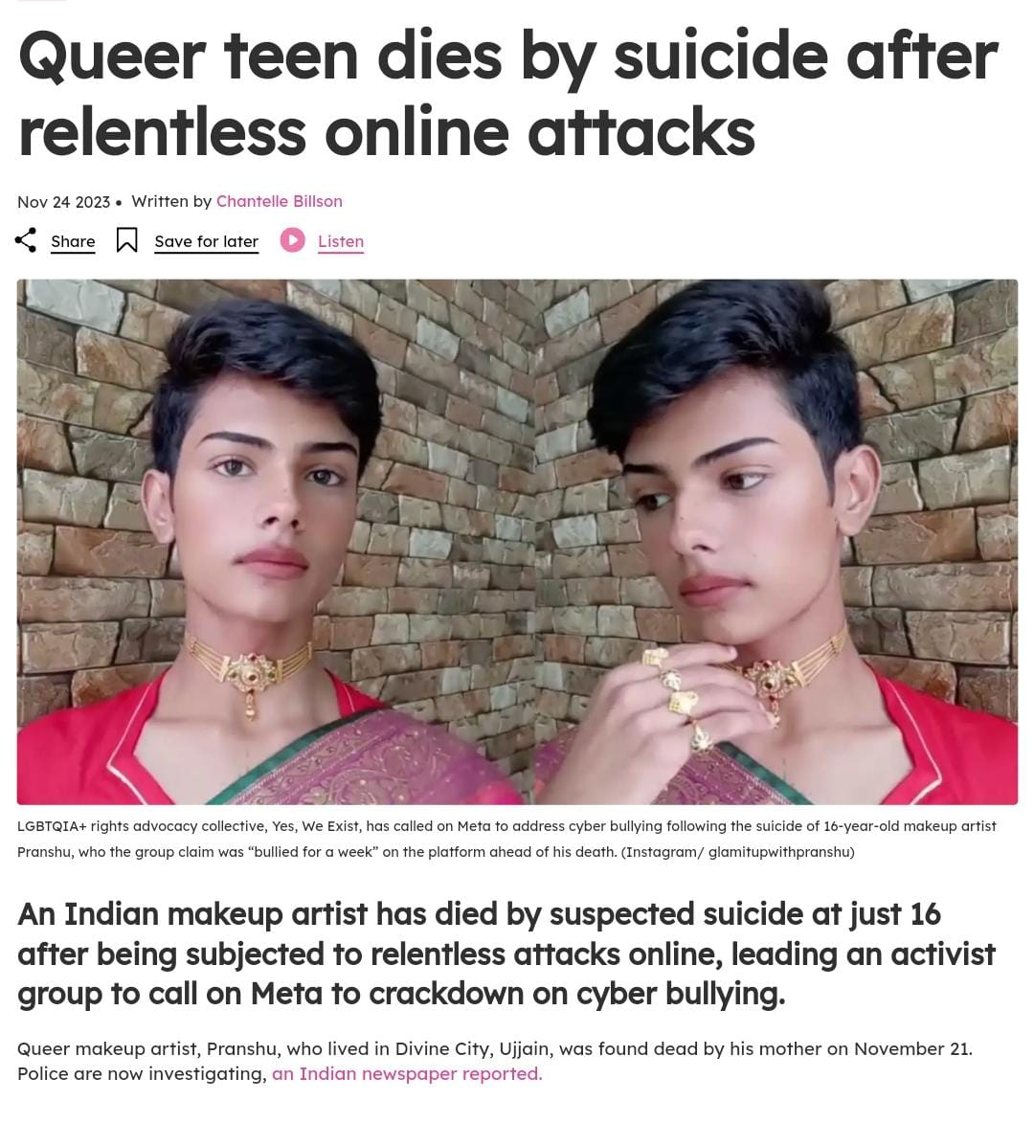
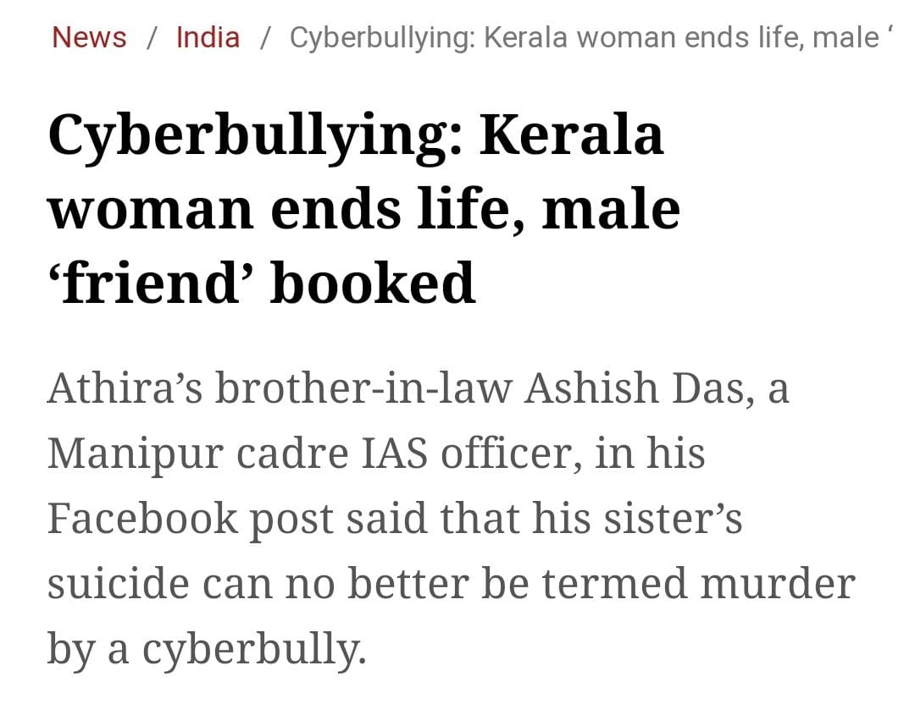
Recent Cases

Slide 9


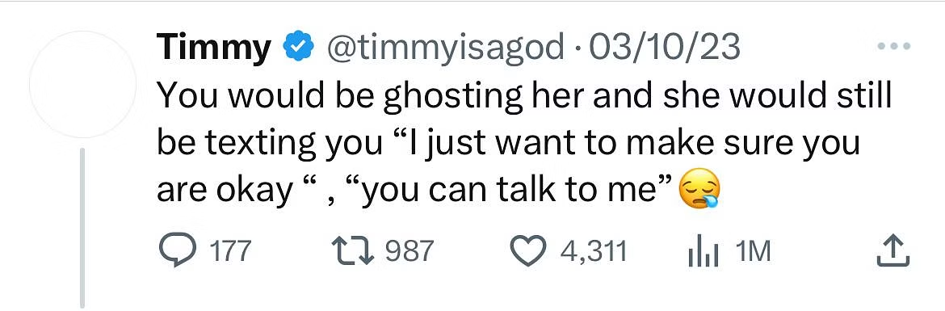
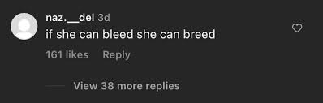
Celebrity Impersonation/ Giveaway Scams:
Twitter’s Cancel Culture:
Glorifying toxicity as being cool:

Slide 10
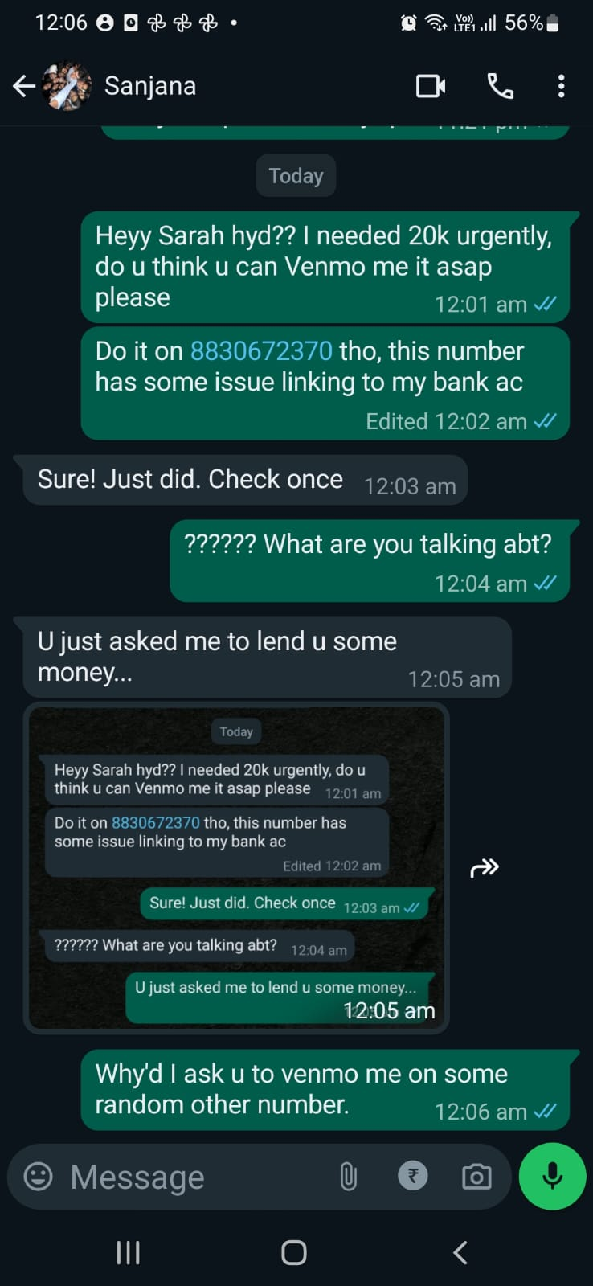
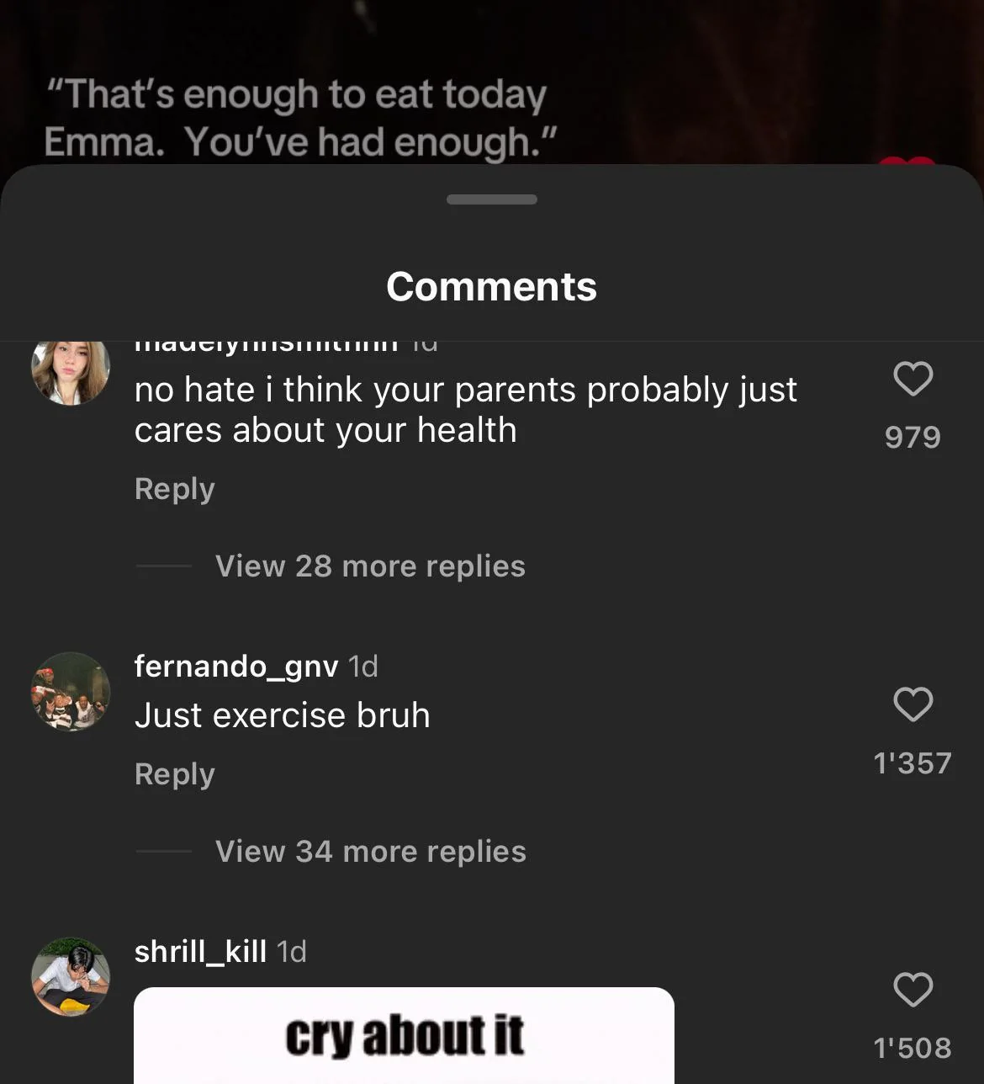
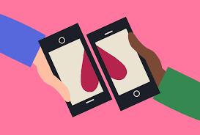
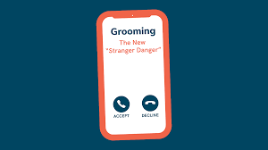
Phishing Scams
Hateful Comments
E dating
Blackmailing & Grooming

Slide 11
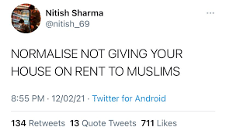
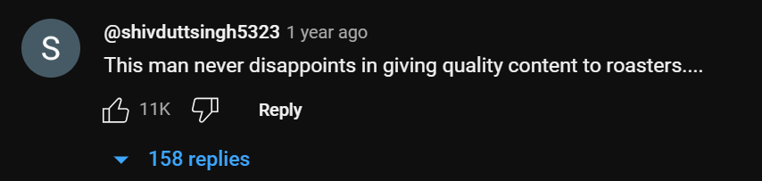
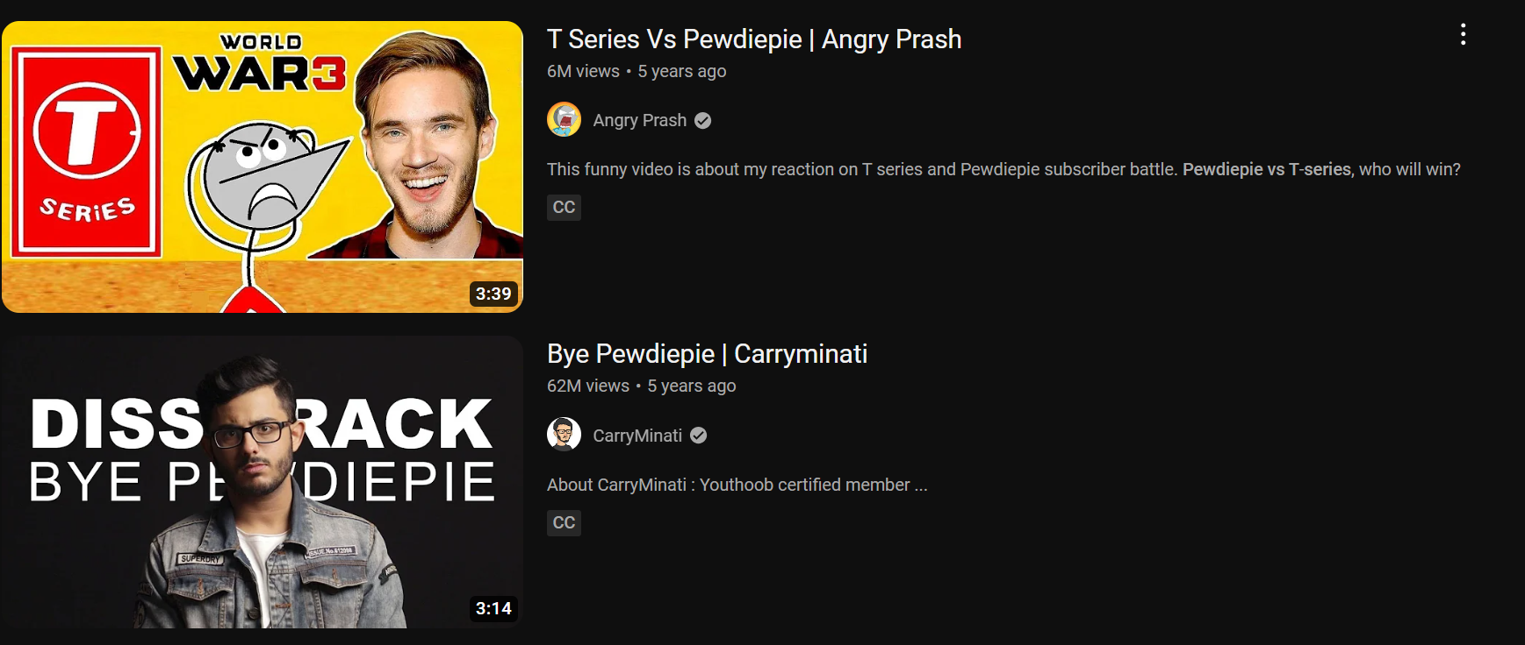
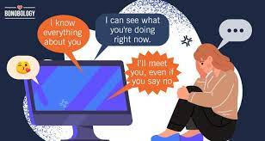
Offensive Normalizing Culture:
Hate Speech:
Diss Tracks, Trolls, Roasts, Fandom Wars:
Cyber Stalking:

Slide 12
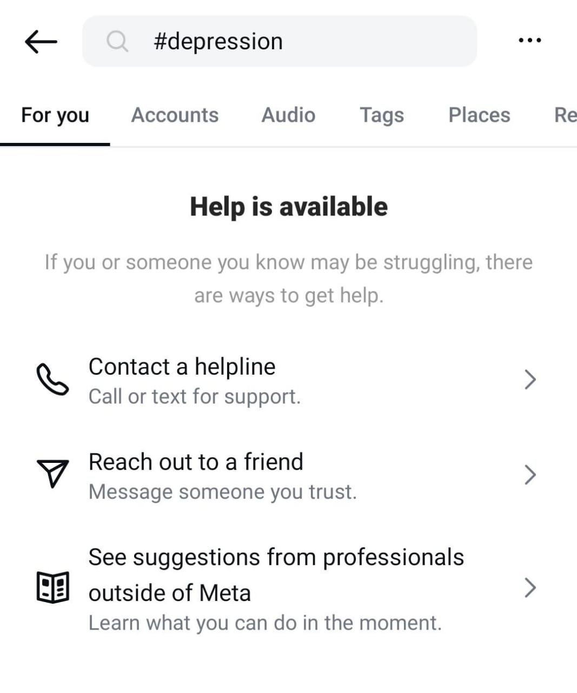
Measures
Parental Involvement
Anonymous Reporting
Strong Community Guidelines
Algorithmic Intervention
Promoting Positive Content

Slide 13
Techniques used in SMA to identify signs of mental health issues:
1. Natural Language Processing (NLP): Unstructured Text Mining, Sentiment analysis. (Ambiguity/Sarcasm)
2. Keyword Analysis like "sad," "lonely," "depressed," "anxious" related to depression, anxiety, or other mental health issues are identified.
3. Semantic Analysis: Examines the meaning and context of words and phrases to understand the underlying emotions to detect subtleties.
4. Topic Modeling: Identify common themes or topics discussed in social media conversations.
5. Social Network Analysis: Analyzing the user's social network connections and interactions can provide insights into their social support system and potential sources of stress. Eg. Ghosting or Isolation, etc.
6. ML Algorithms: Notice unusual behavior of the user.
7. Time Series Analysis: Tracking changes in language usage, sentiment, or social interactions over time can reveal patterns indicative of mental health deterioration or improvement. - Longitudinal analysis provides a better understanding of the user's mental health trajectory.

Slide 14
Walking through the Algorithm for an Example Tweet:
1. Input Tweet: "Nice Hidden Talent ♡, Keep it Hidden!!!"
2. Text Preprocessing:
- Tokenization: ["Nice", "Hidden", "Talent", "♡", ",", "Keep", "it", "Hidden", "!!!"]
- Lowercasing: ["nice", "hidden", "talent", "♡", ",", "keep", "it", "hidden", "!!!"]
- Removing Stopwords: ["nice", "hidden", "talent", ",", "keep", "hidden"]
3. Feature Extraction:
- Word Embeddings: Convert each token into a dense vector representation using pre-trained word embeddings (e.g., Word2Vec, GloVe), Feature Selection: ["nice", "talent", "hidden"]

Slide 15
4. Machine Learning Classification:
- Train Classifier: Use a machine learning classifier (e.g., Support Vector Machine, Naive Bayes) trained on labeled data to classify the tweet into sentiment categories (e.g., positive, negative, neutral).
- Input Features: ["nice", "hidden", "talent", "keep", "hidden"]
- Predict Sentiment.
5. Output Sentiment Analysis Result:
- Display Sentiment: Output the predicted sentiment label (e.g., positive) along with the confidence score or probability assigned by the classifier. Here, it is a negative comment, which has a sarcastic tone.

Slide 16
Analyzing a random person's social media activity to identify signs of mental distress for Alex:
1. Web Scraping:
- Use web scraping tools to gather data from Alex's public social media profiles, such as Facebook, Twitter, and Instagram.
- Collect information including posts, comments, likes, and interactions over a specified period.
2. Text Analysis:
- Analyze the content of Alex's posts and comments using natural language processing (NLP) techniques.
- Look for linguistic patterns that may indicate mental distress, such as:
- Use of depressive language ("I feel worthless", "I can't go on anymore").
- Expressions of anxiety or stress ("I'm constantly worried", "I can't sleep at night").
- References to self-harm or suicidal ideation ("I want to disappear", "I can't handle this anymore").

Slide 17
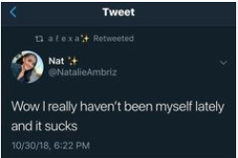
3. Sentiment Analysis:
- Conduct sentiment analysis to evaluate the overall sentiment of Alex's posts.
- Look for trends indicating a predominance of negative sentiment or a shift towards increasingly negative language over time.
4. Visualization Tools for Insights:
Generate word clouds to visualize the frequency of specific keywords.
Create sentiment trend graphs to visualize changes in sentiment over time, highlighting periods of increased negativity or distress.
Use network visualization tools to map Alex's social connections and identify key relationships or sources of support.

Slide 18
5. Comparison and Benchmarking:
- Compare Alex's social media activity and sentiment trends to established benchmarks or norms for mental well-being.
- Look for deviations or patterns that indicate a departure from expected norms and may suggest underlying mental health issues.
- Peer Comparison: Compare the individual's social media activity and sentiment trends to those of their peers or similar demographics, providing context and insight into their relative mental health status within their social circle.
6. Early Intervention and Support:
- Set up automated alerts or notifications to flag concerning patterns or keywords in Alex's social media activity, enabling timely intervention.
- Recommend mental health resources, support services, or helplines based on the identified signs of distress, offering Alex personalized support and assistance.

Slide 19
Statistics
Effects of Social Media on Mental Health
56% of Americans aged 18-29 experience anxiety when they are not able to access their social media accounts.
In a 2020 survey of more than 6,000 individuals aged 10–18 years, about half of them had experienced cyberbullying.
A 2019 study linked social media use to disrupted and delayed sleep, Approximately 21% of adults wake up to check their phones during the night,
There was a 25% increase in suicide attempts among teenagers between 2009 and 2017 in the U.S.
A population-based study showed a decline in mental health in the U.S., with a 37% increase in the likelihood of major depressive episodes among adolescents.

Slide 20

59% of US teens experienced cyberbullying or online harassment.
Experiencing psychological distress in young adults grew by 71% from 2008 to 2017
The rate of adolescents reporting symptoms of major depression increased by 52% from 2005 to 2017.

Slide 21
Conclusion
Patterns extracted from content lying around several social media platforms can be useful to users, clinicians, and researchers alike to determine the underlying factors that affect individuals.
Behavioral Analysis of users eg. Posting Frequency, Engagement Patterns, etc. can be done alongwith Video/Content Analysis, Geolocation Data analysis.
As an application of data analytics this presents challenges in dealing with big data, data visualization, pattern recognition, document clustering, and information retrieval. This also proposes our responsibility to create healthier online environments and understand Importance of digital literacy and responsible social media use.

Slide 22
References
Karim F, Oyewande AA, Abdalla LF, Chaudhry Ehsanullah R, Khan S. Social Media Use and Its Connection to Mental Health: A Systematic Review. Cureus. 2020 Jun 15;12(6):e8627. doi: 10.7759/cureus.8627. PMID: 32685296; PMCID: PMC7364393.
Beyari H. The Relationship between Social Media and the Increase in Mental Health Problems. Int J Environ Res Public Health. 2023 Jan 29;20(3):2383. doi: 10.3390/ijerph20032383. PMID: 36767749; PMCID: PMC9915628.
Khalaf A M, Alubied A A, Khalaf A M, et al. (August 05, 2023) The Impact of Social Media on the Mental Health of Adolescents and Young Adults: A Systematic Review. Cureus 15(8): e42990. doi:10.7759/cureus.42990

Slide 23
Any Questions?
Go ahead and make use of Social Media and try to find answers to them!
Link to the paper:
https://www.omicsonline.org/open-access/social-media-analytics-for-behavioral-health-1522-4821-1000255.php?aid=61167

